Slide 1



USED VEHICLE PRICE PREDICTION
Sanjay Jaras, Satish Agrawal
DSC-630
Bellevue University

Slide 2
Introduction and problem statement
Price of a used vehicle is very important and needs to be consistent and fair.
There are variety of factors that impact the price of a used vehicle.
This project uses a dataset with various features about the vehicles listed and sold in the past and attempts to predict a price for new listings.
This will be useful in coming up with a fair price of the used vehicles, keeping the margin and market conditions in mind.

Slide 3
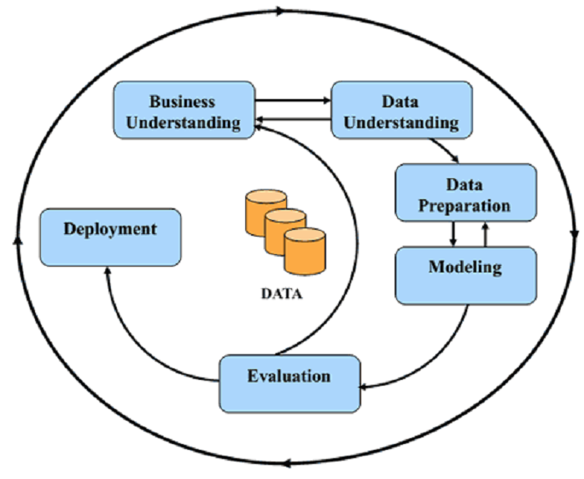
MAJOR STEPS
Data understanding
Split the data set into train and test set
Exploratory analysis of the data set
Data cleaning and preparation
Feature selection and feature engineering
Exhaustive model training
Model evaluation and selection
Testing with test data
Discuss the best model and Model deployment

Slide 4
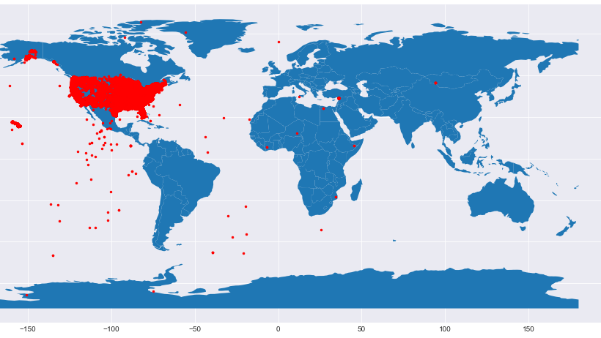
The dataset used in this analysis is from Craigslist and has more than 458K observations of used vehicles listings.
There are 25 attributes in the data set for each listing.
The price for the vehicle is in the dataset and is our target variable that we are trying to predict using machine learning models.
Key attributes are odometer, make and model, year, fuel type and transmission.
We kept 20% of the data aside for testing the model trained on 80% of the dataset.
Dataset

Slide 5
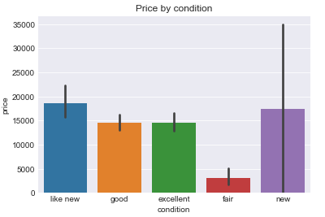
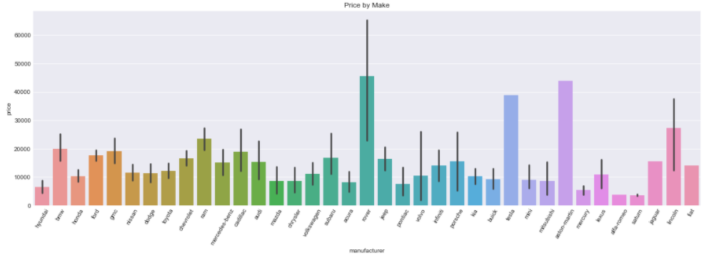
We performed EDA on most of the attributes to understand the distribution and find any correlations with target variable.
The two figures here shows the correlation of condition and make with the target variable, the price of the vehicle.
We generated correlation matrix between all the numeric attributes to see the impact of individual variables into the target variable.
We analyzed values for categorical variables for anomalies and inconsistencies.
EXPLORATORY DATA ANALYSIS

Slide 6
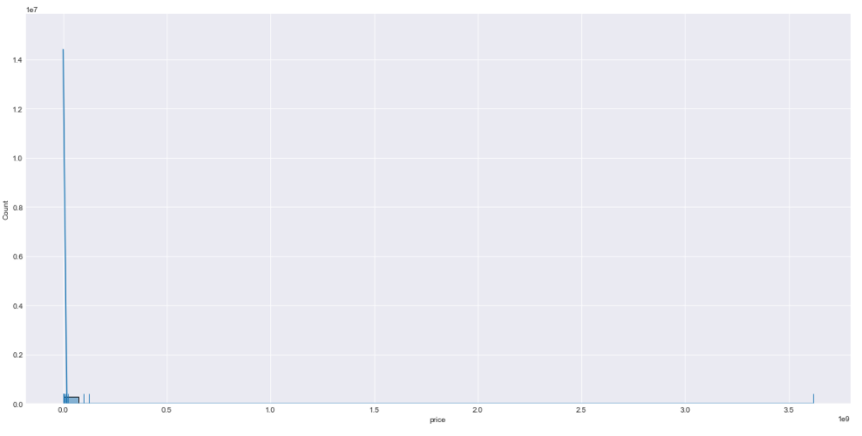
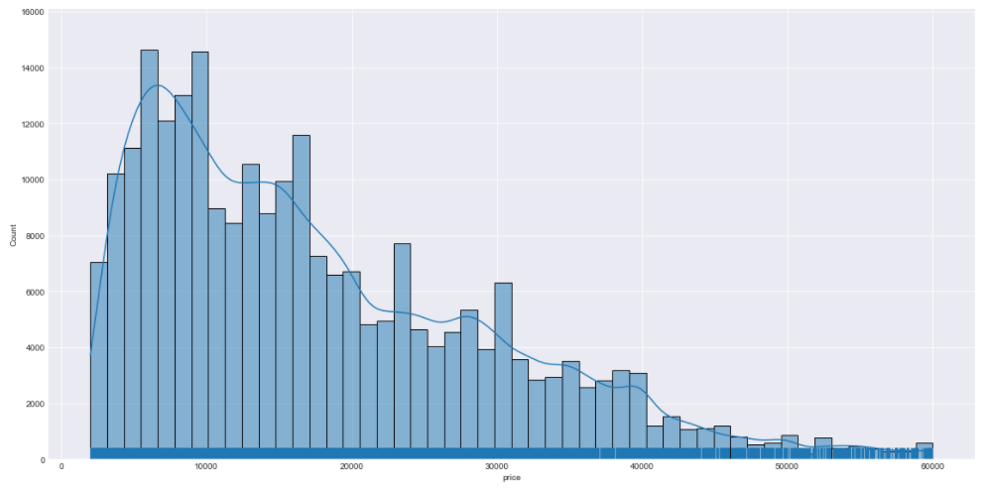
Data cleaning and preparation
We removed the outliers from price, year and odometer.
Above graphs show the distribution before and after outlier removal for price.
We identified and imputed missing values using iterative imputer with ExtraTreesRegressor.
We also removed the feature “size” because it has more than 50% missing values and may not be as helpful in price prediction.

Slide 7
Feature selection and engineering
We removed following attributes from the dataset, considering they do not have any correlation with the target variable or highly correlated with other features and are duplicates :
URL
ID
Image_URL
Description
Region_URL
VIN
These features do not have any correlation with the price of the car and may not contribute towards making price prediction
We used model year and listing date to derive the age of the car at the time of listing. Age has an important role to play in price prediction.

Slide 8
Training models
Training is the process of applying available data to the chosen algorithm(s).
We chose to train Linear regressor, DecisionTreeRegressor, XGBRegressor and RandomForestRegressor models.
Training multiple models allows comparing and choosing the best performing model.
We employed exhaustive search technique to train multiple models for the same algorithm and tune the hyperparameters to come up with the best model.
We ended up training 85 models in total with cross validation.

Slide 9
Model selection and scoring metrics
Model selection is the process of selecting the best performing model with the best hyperparameters
Scoring metrics allow comparing assorted models.
There are many scoring metrics to choose from including Max error, r-square, explained variance, accuracy, F1 score etc.
We chose accuracy be the scoring metrics for our model evaluation and selection process.
K-fold cross validation splits data into K-folds and uses K-1 folds to train a model and remaining one-fold to validate the performance using the metric provided.
We used 5-fold cross validation.

Slide 10
MAJOR CHALLENGES AND RESOLUTIONS
Though dataset has around 485k observations only, but we have many categorical features with long list of supported values, one hot encoding has increased the number of attributes in the set and was crashing the program while traning.
Dataset has many categorical attributes. Using one-hot encoding was making model overfit.
As we split the dataset before in hand, we saw missing categories in the training dataset which were present in the test dataset.
To avoid above issue, we delayed the split of the dataset which was potentially introducing data snooping issues to the project.
We found that sklearn has a newer version 0.24 where this has been handled and it worked fine for us.

Slide 11
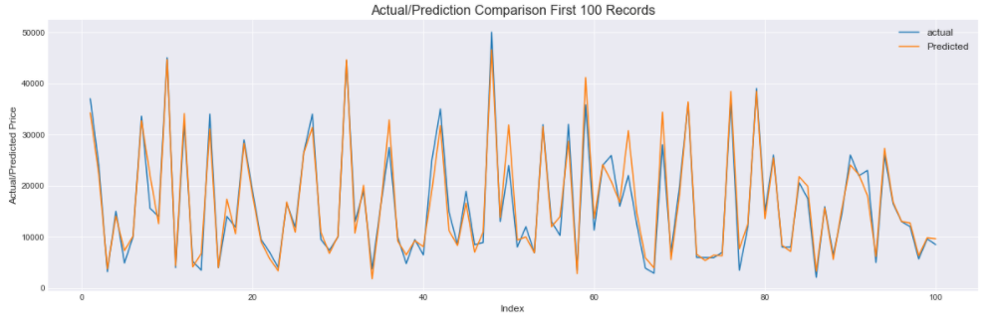
At this point of the analysis, we have achieved 93% of accuracy in used vehicle price prediction.
Graph above shows predictions are accurate or close to the actual price for the vehicles.
We are planning to work towards using PCA/SelectKBest for selecting best correlated attributes to achieve better performance.
We are exploring options to use Model ensembles to gain better accuracy.
If we have other features like improvements to the vehicle or accessories added, would help improvise the prediction.
Outcome and next steps

